Slide 1
Information Technology Investment: Decision Making Methodology
Chapter 1
Introduction to Information Technology Investment Decision-Making

Slide 2
I. Introduction
A statements that is seemingly contradictory or opposed to common sense and yet is true
The productivity paradox: The absence of a positive relationship between spending on information technology (IT) and its resulting contribution to productivity or profitability.
There needs to be a way to show this relationship to justify the investment!
Payback

Slide 3
I. Introduction
Level of Analysis
Economy : negative??
Industry : mixed ??
Firm : positive??
Robert Solow felt…
Other researchers have been surprised…
Several other researchers have found that…
No single methodology that’ll give a consistent IT investment solution

Slide 4
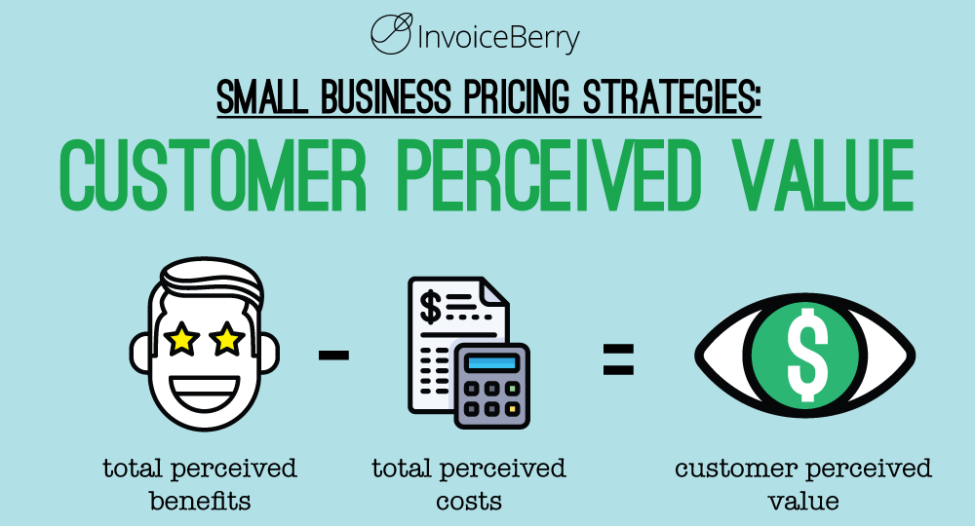
II. Types of IT Investment Decision-Making Problems
Complexity in even the simplest of IT decision-making problems can offer challenge to managers.
Need to show that IT investment returns “perceived value” to the firm
Factors (Selection criteria) | Measures | Scale used to in measure
1. Cost | Dollars | Number of dollars
2. Primary features | OS Monitor CPU Memory Weight Design | Window, Mac Size and Resolution Maker, clock Main Cache Hard 980g, 1,200g,… Ranking of Ganji(style and tastes)
3. Secondary features | Multimedia Input Mode Interface | Graphic, Memory, Audio&sound Pen, Touch screen, Voice,… USB, External GPU,…

Slide 5
II. Types of IT Investment Decision- Making Problems
IT investment decision-making problems:
What are the most appropriate quantitative methods and techniques for the evaluation of IT ?
What quantitative and qualitative measures can be used in the assessment and evaluate IT investments?
How can we objectively render an IT decision when we use highly complex, multiple and conflicting criteria?
How do we choose the best alternative from a set of alternative IT projects?
How can we justify our IT decisions?

Slide 6
III. What are IT Investment Decision-Making Methodologies?
Personnel
IT investment can be defined as the investment decisions of allocating all types (i.e., human, monetary, physical) of resources to an IS
tangible vs. intangible
quantitative and qualitative
Various methodologies
in Table 2.
Personnel
Application software
Appl. Software
System software
Sys. Software
Hardware
Hardware
Information System

Slide 7
IV. Why Study IT Investment and Decision-Making Methodologies
Means of achieving competitive advantage
By helping stakeholders (stockholders + partnering companies) perform their biz functions much better
Multiply the efficiency and productivities of one firm over another
Poor investments can be a competitive disadvantage
By increasing costs, delaying orders, disrupting communications, and decreasing employee morale

Slide 8
V. Organizational Strategic Planning in IT Investment Decision-Making
Tactical planning is performed by middle-level managers, such MIS department heads and directors
- Make IT investment DM
Strategic planning is performed by senior management including vice presidents in MIS
- Set goals and objectives
All planning follows a hierarchical planning process of stages
Strategic planning
Tactical planning
Operational planning
Operational planning is performed by first line -level managers, including project managers and MIS supervisors
- Set day-to-day work effort

Slide 9
V. Organizational Strategic Planning in IT Investment Decision-Making
1. External analysis of competition and threats
2. Internal analysis of firm’s strengths
and weaknesses
Strategic
planning
steps
3. Overall corporate strategic planning
4. MIS functional area strategic planning
This figure details the IS hierarchical planning of IT systems
5. Process and systems engineering
Tactical
planning
steps
6. Configuration and functionality analysis
Our focus is mainly on the Tactical Steps and particularly Step 5, 6, 7, and 9
7. IT system evaluation and justification
8. IT system implementation
Operational
planning
steps
9. Post implementation analysis

Slide 10
V. Organizational Strategic Planning in IT Investment Decision-Making
All organization planning begins at the top:
Strategic Plan For Organization-wide
Growth in sales
Alignment
Strategic Plan
For IT
Expand information systems capability to handle growth in sales
Tactical Plan
For IT
Purchase new information systems to increase sales growth capability
Operational Plan For IT
Make the new information systems work to actually handle new sales

